Slide 1
Glutamate Transporters: Link with Depression, Memory, Learning & Fixes
Decision Making During Depression
Spring 2017, BioL-792
Atia B. Amin

Slide 2
Glutamate: An Excitatory Neurotransmitter
Most abundant neurotransmitter in the vertebrate nervous system
The carboxylate anion of glutamic acid
It is synthesized in the central nervous system from glutamine
Glutamine can also be converted into glutamate in glutamate-glutamine cycle
Notes:
accounting in total for well over 90% of the synaptic connections in the human brain, as part of the glutamate-glutamine cycle by the enzyme glutaminase

Slide 3
Glutamate Vs Glutamine

Slide 4
Glutamate: An Excitatory Neurotransmitter
Neurons are not able to synthesize new glutamate from glucose
Interconversion of glutamate and glutamine is needed to balance the level of glutamate in CNS
Glutamate-glutamine cycle works between neurons and astrocytes
Notes:
The glutamate/GABA-glutamine cycle is a metabolic pathway that describes the release of glutamate or GABA from neurons which are then taken up into astrocytes (star shaped glial cells). In return, astrocytes release glutamine to be taken up into neurons for use as a precursor to the synthesis of glutamate or GABA.^{[2]}

Slide 5
Glutamate System
In brain, glutamate works in a fast-signaling system
Important for information processing in neuronal networks
Two major components of glutamatergic system,
Glutamate Receptors
Glutamate Transporters

Slide 6
Glutamate Receptors
Glutamate receptors are synaptic receptors located primarily on the membranes of neuronal cells
Responsible for the glutamate-mediated post synaptic excitation of neuronal cell
Type | Name | Agonist(s)
Ionotropic | NMDA Receptor | NMDA
 | Kainate Receptor | Kainate
 | AMPA Receptor | AMPA
Metabotropic | mGluR | LAP4, ACPD, L-QA

Slide 7
Glutamate Receptors

Slide 8
Glutamate Transporters
Glutamate cannot cross the blood brain barrier unassisted
Actively transported into the nervous system by a high affinity transport system
Two primary subclasses:
Excitatory Amino Acid Transporters (EAATs)
Vesicular Glutamate Transporters (VGLUTs)

Slide 9
Glutamate Transporters
protein | gene | tissue distribution
EAAT1 | SLC1A3 | Astroglia
EAAT2 | SLC1A2 | Mainly astroglia mediates >90% of CNS glutamate reuptake
EAAT3 | SLC1A1 | all neurons – located on dendrites and axon terminals
EAAT4 | SLC1A6 | neurons
EAAT5 | SLC1A7 | retina
VGLUT1 | SLC17A7 | neurons
VGLUT2 | SLC17A6 | neurons
VGLUT3 | SLC17A8 | neurons

Slide 10
Glutamate Transporters

Slide 11
Glutamate-Glutamine Cycle
Important to maintain adequate supply of the glutamate in CNS
There are three steps, as follows:
Uptake into the postsynaptic compartment
Re-uptake into the presynaptic compartment
Uptake into a third, non neuronal compartment

Slide 12
Glutamate-Glutamine Cycle
There are three steps, as follows:
Uptake into the postsynaptic compartment
Re-uptake into the presynaptic compartment
Uptake into a third, non neuronal compartment

Slide 13
Physiological Functions
The Functions include,
Memory and learning
Memory Creation and Management
Messaging for Body
Human Thought Process
Glutamate pathways are linked to many other neurotransmitter pathways
Found throughout the brain and spinal cord in neurons and glia

Slide 14
What are the effects of glutamate imbalance?

Slide 15
Effects
Glutamatergic system dysfunction in major depression (MD) and bipolar disorder (BPD)
Glutamate accumulate in the extracellular fluid at high concentration leads to neuronal cell death
Increased glutamate levels found in the hippocampus and amygdala in preclinical stress models

Slide 16
Hypothesis
Expression of glutamate transporters might be related to depression like behavior, acquisition and impairment in memory and learning and antidepressant effect of ketamine

Slide 17
Topic Paper
INVOLVEMENT OF PGLUR1, EAAT2 AND EAAT3 IN OFFSPRING DEPRESSION INDUCED BY PRENATAL STRESS

Slide 18
Two Hypothesis
Prenatal stress might cause depression-like behavior to offspring rats
Offspring depression might involve aberrations in the glutamatergic system

Slide 19
Prenatal Stress
Stress that a mother experiences during her pregnancy
It can be,
Chronic, linked to ongoing events in a woman’s life
Acute, linked to sudden changes in routine or environment

Slide 20
Prenatal Stress and Juvenile Depression
Raise the risk of psychiatric disorders to offspring, such as
Conduct disorder
Impaired cognitive development
Schizophrenia
Attention deficit hyperactivity disorder (ADHD)

Slide 21
Restraining Rats
Sprague–Dawley pregnant rats are assigned to
Mid prenatal stress group (MPS, n = 6)
Late prenatal stress group (LPS, n = 6)
Control group (CON, n = 6)
Notes:
The pregnant rats of MPS and LPS group were separately exposed to restraint stress on days 7–13, 14–20 of pregnancy three times daily for 45 min
To prevent habituation of animals to the daily procedure, restraint periods were randomly shifted.
The restraint device was a transparent plastic tube with air holes for breathing and closed end.
The pregnant rats of the CON were left undisturbed

Slide 22
Tail Suspension Test
Ten male and 10 female rats from each group were used
One-month-old SD rat was hung for 6 min by the tail
Total duration of immobility and the latency of immobility were calculated

Slide 23
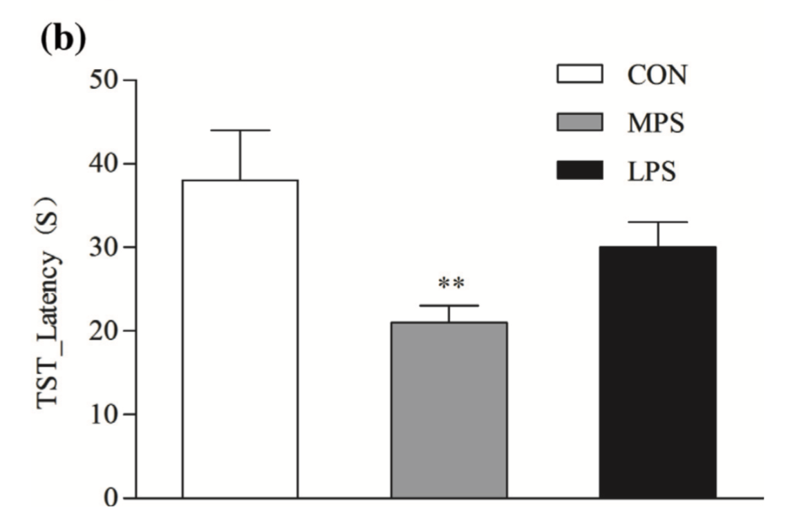
Fig. 1. Effects of prenatal stress in the tail suspension test of 1- month-old rat offspring. Immobility time and latency of immobility, shown by control (CON) and MPS and LPS offspring rats at 1 month of age (n = 20, 10 males and 10 females)
Notes:
Furthermore, research has discovered that prenatal restraint stress produced an increase in immobility time in female mice offspring

Slide 24
Aberration in Glutamatergic System
Changes in the expression of,
The main glial transporter EAAT2
The main neuronal glutamate transporter EAAT3
The phosphorylation state of GluR1 subunit of AMPAR
Particularly in the hippocampus, frontal cortex and striatum of offspring rats

Slide 25
Hippocampus, Frontal Cortex, Striatum

Slide 26
pGluR1 Expression
Phosphorylation state of GluR1 subunit (Ser845) of AMPAR
Critical for AMPAR trafficking in the postsynaptic membrane
In the hippocampus, pGluR1 (Ser845) expression was significantly affected by PS

Slide 27
Hippocampal Expression of pGluR1
PS significantly attenuated pGluR1 (Ser845) level of MPS group

Slide 28
EAAT2 Expression
Effect of prenatal stress on the glial glutamate transporter EAAT2 mRNA expression assessed in
The hippocampus
Striatum and
Frontal cortex of offspring rats at 1 month of age

Slide 29
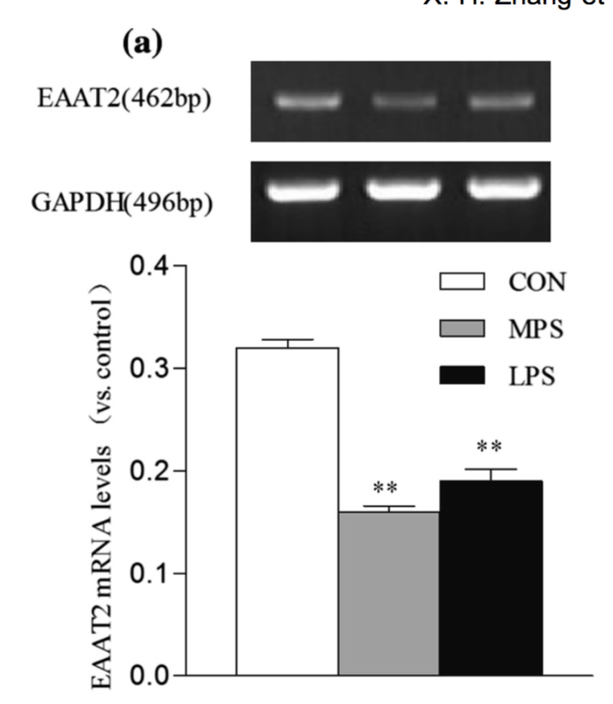
Hippocampal Expression
EAAT2 mRNA expression in the hippocampus revealed a significant main effect of prenatal stress
Mid and late prenatal manipulation significantly decreased EAAT2 expression in juvenile rat offspring
Fig: Effect of prenatal stress on the EAAT2 mRNA expression assessed in the hippocampus

Slide 30
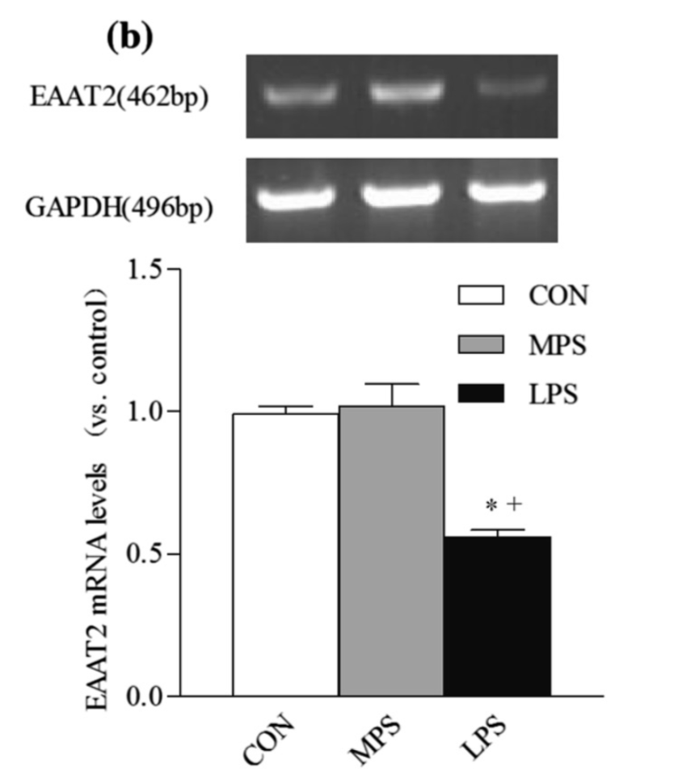
Expression in Striatum
EAAT2 level in the striatum of juvenile rat offspring in the LPS group was significantly reduced compared to CON
Fig: Effect of prenatal stress on the EAAT2 mRNA expression assessed in the Striatum

Slide 31
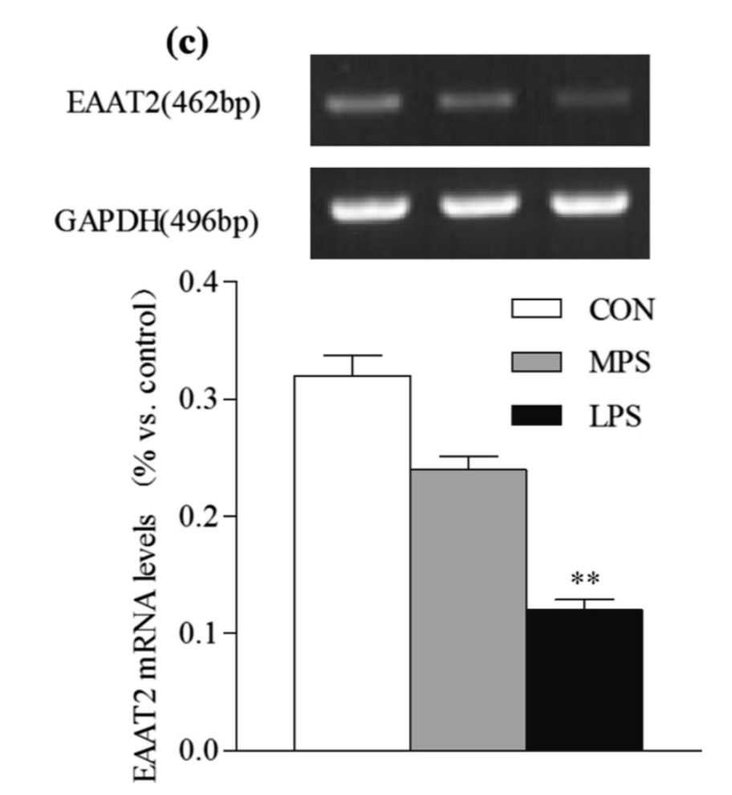
Expression in Frontal Cortex
Mid and late prenatal manipulation significantly decreased EAAT2 expression in juvenile rat offspring in frontal cortex
Fig: Effect of prenatal stress on the EAAT2 mRNA expression assessed in the frontal cortex

Slide 32
EAAT3 Expression
Effect of prenatal stress on the neuronal glutamate transporter EAAT3 mRNA expression assessed in
The hippocampus
Striatum and
Frontal cortex of offspring rats at 1 month of age

Slide 33
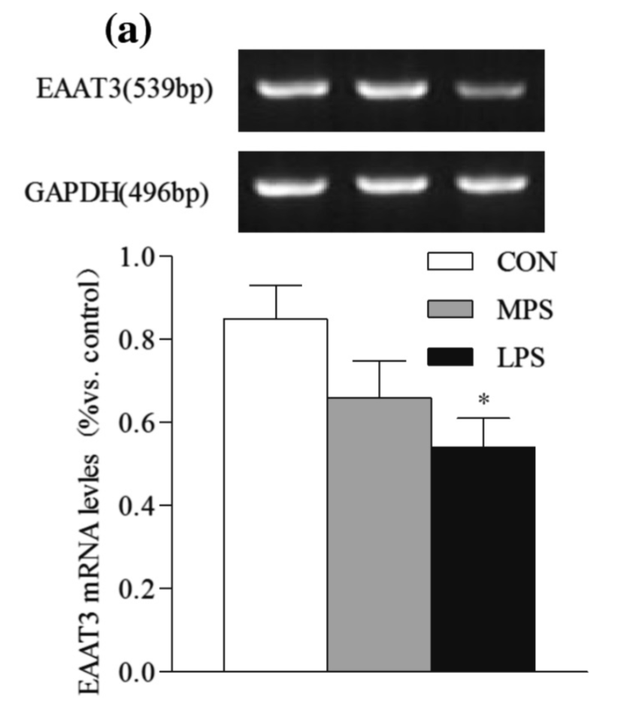
Hippocampal Expression
Neuronal glutamate transporter EAAT3 mRNA expression in the hippocampus revealed a significant main effect of PS
Fig: Effects of prenatal stress on the EAAT3 mRNA expression assessed in the hippocampus

Slide 34
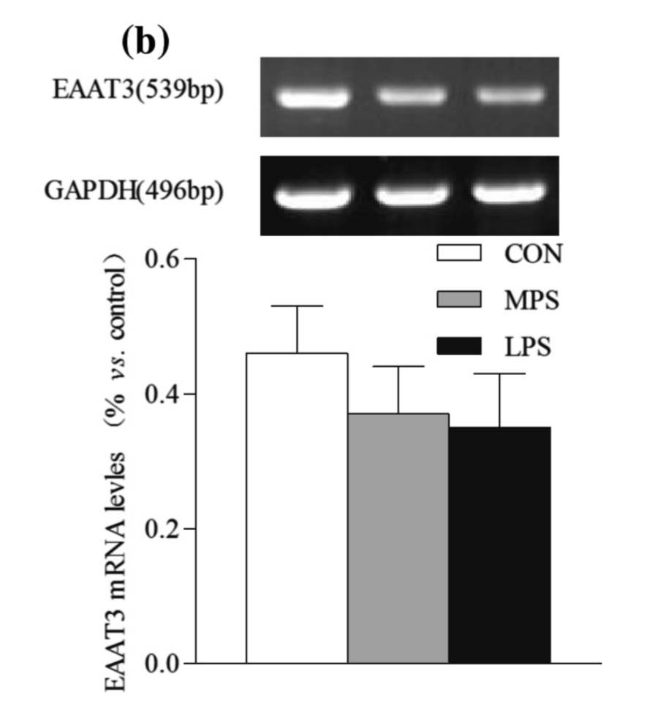
Expression in Striatum
Neuronal glutamate transporter EAAT3 mRNA expression in the striatum did not revealed an effect of PS
Fig: Effects of prenatal stress on the EAAT3 mRNA expression assessed in the striatum

Slide 35
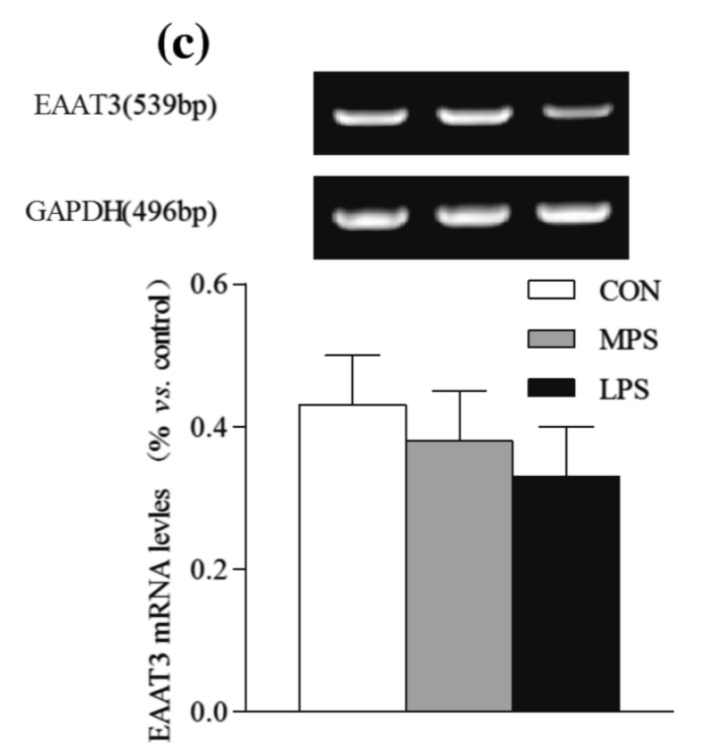
Expression in Frontal Cortex
In the frontal cortex, EAAT3 mRNA expression was not affected by PS
Fig: Effects of prenatal stress on the EAAT3 mRNA expression assessed in the frontal cortex

Slide 36
Discussion
Significant reduction of EAAT2 mRNA level in the hippocampus, striatum and frontal cortex of both male and female rats of stress group
Significant reduction of EAAT3 mRNA expression in the hippocampus of the LPS group
No difference between LPS and MPS groups of behavioral responses and glutamatergic system,
Except for reduced EAAT2 mRNA expression in the striatum in the LPS group compared to the MPS group
Notes:
Such disagreement might be due to the intensity and duration of stress and the animal species.

Slide 37
Discussion
The decline of EAAT2 expression in the three brain region and EAAT3 reduction in the hippocampus might lead to the accumulation of glutamate in the synaptic cleft
This might contribute to the prenatal stress induced depression like behavior in offspring rats
EAAT2 mRNA reduction is more distinct than EAAT3. So, EAAT2 might play a more crucial role in the process of depression- like behavior

Slide 38
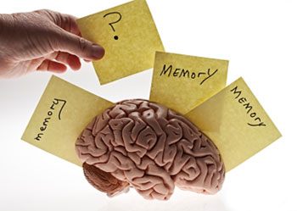
Decision Making Paper
Expression of VGLUTs contributes to degeneration and acquisition of learning and memory

Slide 39
Memory & Learning
What are the differences between these two phenomena?

Slide 40
Memory & Learning
Learning is a process that will modify a subsequent behavior
Memory, on the other hand, is the ability to remember past experiences
For example, we learn a new language by studying it, but we then speak it by using our memory to retrieve the words that we have learned
Thus, memory depends on learning. But learning also depends on memory
Notes:
Memory and learning are so closely connected that people often confuse them with each other, 2 different phenomena
Memory is essential to all learning, because it lets you store and retrieve the information that you learn. Memory is basically nothing more than the record left by a learning process

Slide 41
Acquisition of Learning and Memory
Memory acquisition is the process of storage and retrieval of new information in memory

Slide 42
Degeneration of Learning and Memory
Learning and memory impairments are characteristic of both normal and pathological aging
What are the underlying neurobiological changes?

Slide 43
Glutamate Transporter
Glutamate cannot cross the blood brain barrier unassisted
Actively transported into the nervous system by a high affinity transport system
Two primary subclasses:
Excitatory Amino Acid Transporter (EAAT)
Vesicular Glutamate Transporter (VGLUT)

Slide 44
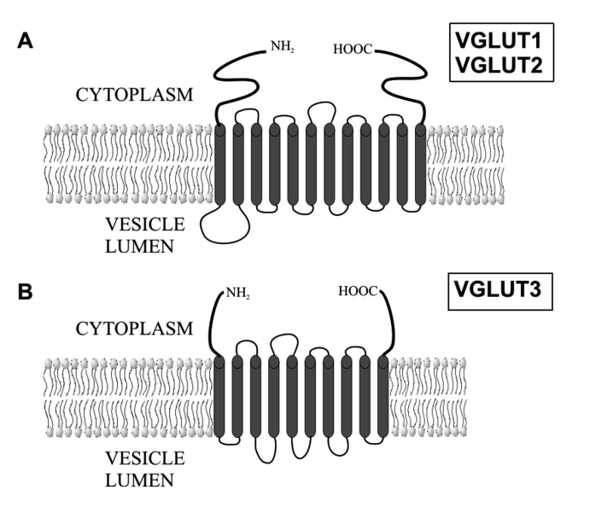
Vesicular Glutamate Transporter(VGLUTs)
Pack glutamate into synaptic vesicles so that they can be released into the synapse
Three distinct isoforms have been identified
VGLUT1
VGLUT2
VGLUT3

Slide 45
VGLUTs are Found…
VGLUT1 and VGLUT2 are specific markers for glutamatergic neurons
VGLUT3 is sparsely expressed in the brain
Fig: Complementary distribution of VGLUT1 and VGLUT2 in the mouse brain (Monika, Jolanta 2007 et al.)

Slide 46
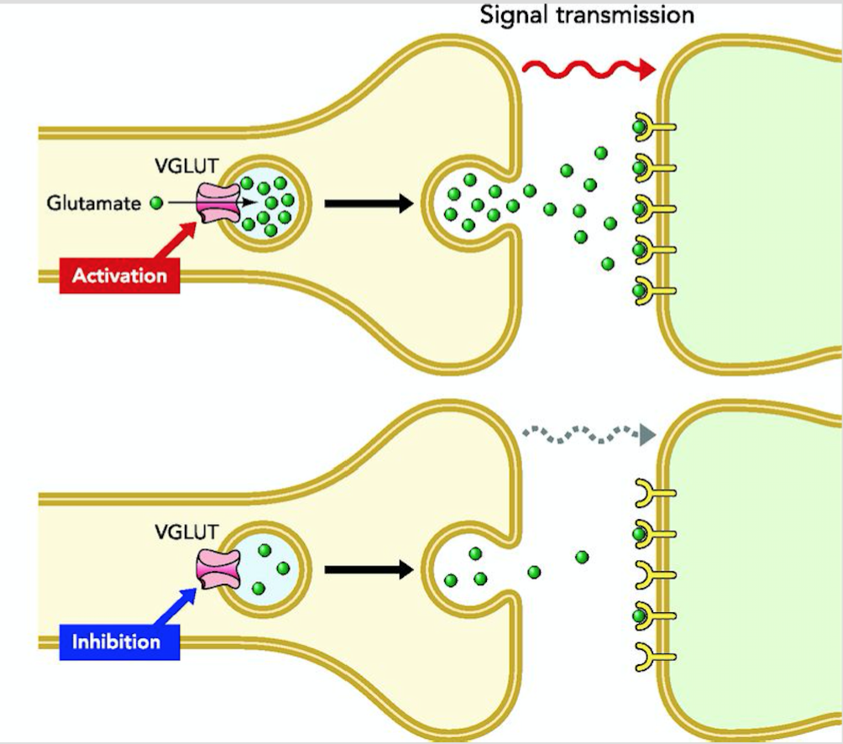
Function of VGLUTs
Upload L-glutamate into synaptic vesicles
Expression pattern of VGLUTs determines the level of synaptic vesicle filling
Directly influence glutamate receptors and glutamatergic signal transmission
Thus VGLUTs may play a key role in learning and memory in the central nervous system

Slide 47
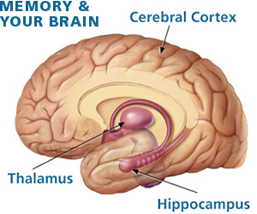
Research Focused on
Hippocampus & Cerebral Cortex
Expression of VGLUT1
Expression of VGLUT2
Expression of VGLUT3
Notes:
The hippocampus and cerebral cortex are brain regions crucial for learning and memory.

Slide 48
Two Hypothesis
Age related impairment of learning and memory in SAMP8 might involve decreased expression of VGLUTs in hippocampus and cerebral cortex
Increased learning and memory performance in KM mice might involve increased expression of VGLUTs in hippocampus and cerebral cortex

Slide 49
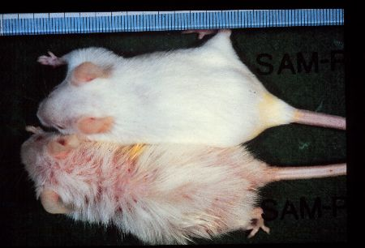
VGLUTs Expression & Degeneration of Memory and Learning
Used senescence-accelerated mouse/prone 8 (SAMP8) for the age-related impairment of learning and memory
SAM resistant/1(SAMR1) are long-lived with normal aging characteristics and are used as a control strain
Fig: SAMP1(lower) and SAMPR1(upper) males of 12 months old

Slide 50
SAMP8
Age related behavioral changes occur in SAMP8 at 4 months of age
Age-related deficits in learning and memory occur as early as 2 months after birth
SAMP8 exhibits significant impairments in active avoidance tasks
Avoidance responses in SAMP8 did not improve with training but increase in the SAMR1 control group in the shuttle-box test

Slide 51
Results of VGLUT1 Protein expression in SAMR1 and SAMP8
Fig: (C) expression of protein in the hippocampus; (D) expression of protein in the cerebral cortex

Slide 52
Results of VGLUT1 expression in SAMP8
These results showed that VGLUT1 protein expression was decreased in the cerebral cortex and hippocampus of SAMP8, which might be related to the deterioration of learning and memory in SAMP8 mice

Slide 53
Results of VGLUT2 Protein expression in SAMP8 and SAMR1

Slide 54
Results of VGLUT2 expression in SAMP8
A comparison of VGLUT1 and VGLUT2 expression in the hippocampus of SAMR1 and SAMP8 revealed the possibility of complementary VGLUT1 and VGLUT2 function in the same brain region

Slide 55
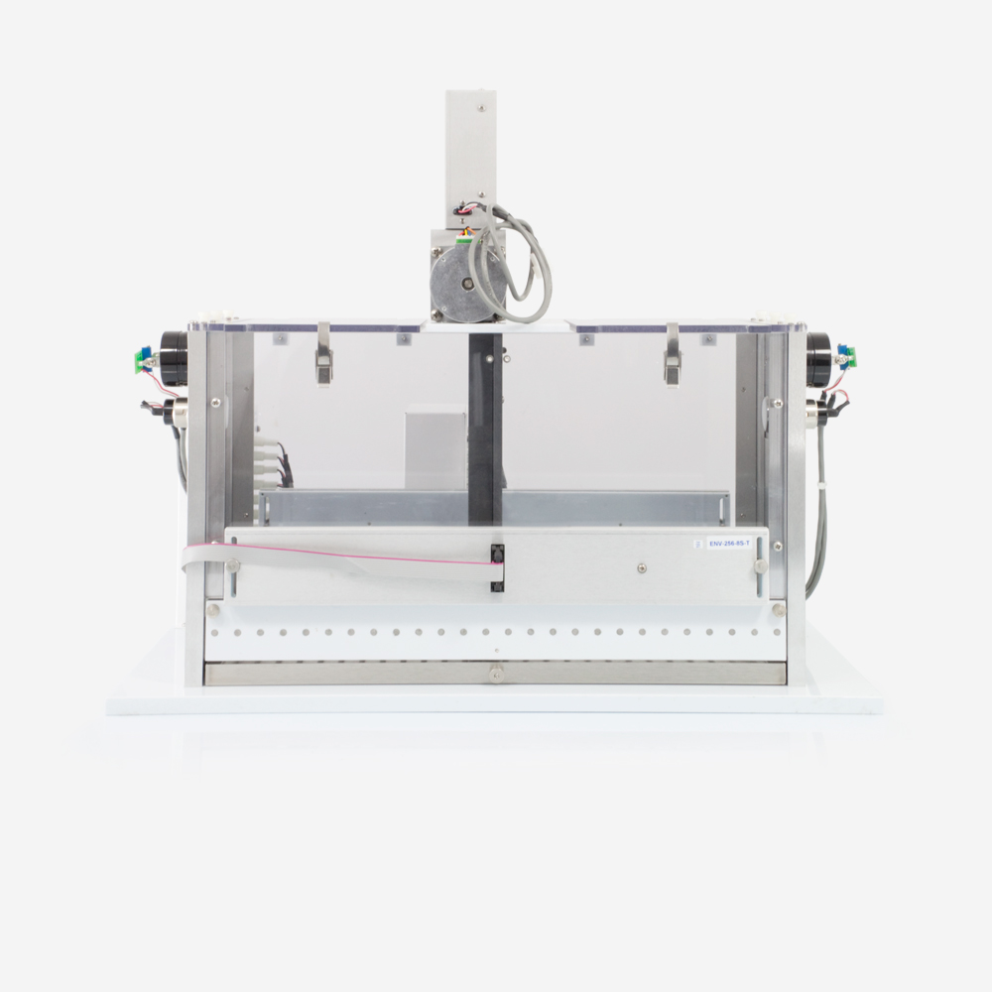
VGLUTs Expression and Acquisition of Memory and Learning
First, learning performance and memory formation in the KM mice were tested with a shuttle- box test.
Shuttle-box test is a multi-trial procedure utilizing complex tasks
Used to assess the learning and memory ability of rodents
Reliable, sensitive and quantitative for active avoidance learning

Slide 56
Shuttle-Box Test

Slide 57
Shuttle Box Test
61 male KM mice were evaluated using the shuttle-box test
Active avoidance response was recorded automatically
Each mouse was given 60 consecutive trials with 20s intervals daily for six consecutive days.
lighting 5s, interval 10s, electric shock 5 s, interval 20s
The learning and memory ability of each KM mouse was assessed as the percentage of the ratio of active avoidance response number to the total avoidance

Slide 58
Shuttle Box Test Result
The control group had five mice that received no shock
Group A contained five mice with a score 0–20
Group B had 10 mice with a score 21–40
Group C had 21 mice with a score 41–60
Group D had 12 mice with a score of 61– 75
And group E had five mice with a score of 76–100
Notes:
All test subjects were divided into six groups depending on the active avoidance response number on the sixth trial day

Slide 59
Protein expression of VGLUTs in the hippocampus and cerebral cortex of KM mice following the shuttle-box test

Slide 60
Results of VGLUT1 Protein Expression

Slide 61
Fig: Correlation between protein expression of VGLUT1 in the cerebral cortex and hippocampus of of KM mice tested by shuttle-box and the ability of learning and memory
Correlation Analysis

Slide 62
Results of VGLUT1 Expression in KM mice
These findings indicate that VGLUT1 protein expression was increased in the cerebral cortex and hippocampus of KM mice and suggest that this is positively correlated with an elevation in learning and memory ability

Slide 63
Results of VGLUT2 Protein Expression

Slide 64
Correlation Analysis
Fig: Correlation between protein expression of VGLUT2 in the cerebral cortex and hippocampus of of KM mice tested by shuttle-box and the ability of learning and memory

Slide 65
Results of VGLUT2 Expression in KM mice
VGLUT2 protein expression was increased in the brain of KM mice with enhanced learning and memory capability
Protein expression in the hippocampus and cerebral cortex was positively correlated with the ability to perform learning and memory.

Slide 66
Results of VGLUT3 Protein Expression

Slide 67
Correlation Analysis
Fig: Correlation between protein expression of VGLUT3 in the cerebral cortex and hippocampus of of KM mice tested by shuttle-box and the ability of learning and memory

Slide 68
Results of VGLUT3 Expression in KM mice
No significant alteration in VGLUT3 protein expression levels in hippocampus. But there was a tendency toward increased expression in cerebral cortex of KM mice
Correlation analysis indicated that there was no correlation of VGLUT3 mRNA and protein expression in the hippocampus and cerebral cortex of KM mice with learning and memory performance in the shuttle-box test

Slide 69
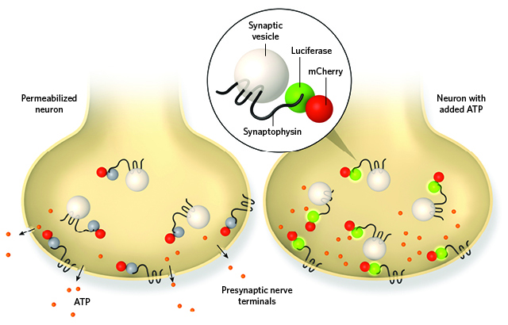
Synaptophysin
Synaptophysin, also known as the major synaptic vesicle protein p38
It regulates endocytosis to ensure vesicle availability during and after sustained neuronal activity

Slide 70
Protein expression of Syp in the cerebral cortex and hippocampus of SAMR1 and SAMP8 with aging

Slide 71
Correlation between protein expression of Syp in the cerebral cortex and hippocampus of KM mice with the ability of learning and memory

Slide 72
Discussion
Glutamate uptake though VGLUTs plays a prominent role in synaptic plasticity which underlies the cellular basis of shuttle-box learning and memory processing
Finally, it has been demonstrated that VGLUT1 and VGLUT2 expression was positively correlated with the ability to learn and memorize and this occurs by affecting glutamatergic signaling which affects behavior
Notes:
In the same brain region, the loss of VGLUT1 function could be compensated for by VGLUT2

Slide 73
Any Anti-depressant Affecting Expression of Glutamate Transporters?

Slide 74
Anti-depressant Ketamine
Every year, 13 to 14 million Americans have major depression
More than 30% of patients exhibit refractory or intolerant responses to current available antidepressant medications
Ketamine is a new generation antidepressant which induces a rapid antidepressant response
Effective in patients who are treatment-resistant to traditional antidepressants

Slide 75
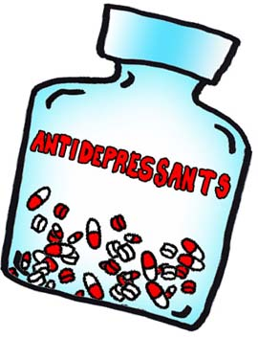
Second Background Paper
Sub-anesthetic doses of ketamine exert antidepressant-like effects and upregulate the expression of glutamate transporters in the hippocampus of rats

Slide 76
Glutamate Transporter
Glutamate cannot cross the blood brain barrier unassisted
Actively transported into the nervous system by a high affinity transport system
Two primary subclasses:
Excitatory Amino Acid Transporter (EAAT)
Vesicular Glutamate Transporter (VGLUT)

Slide 77
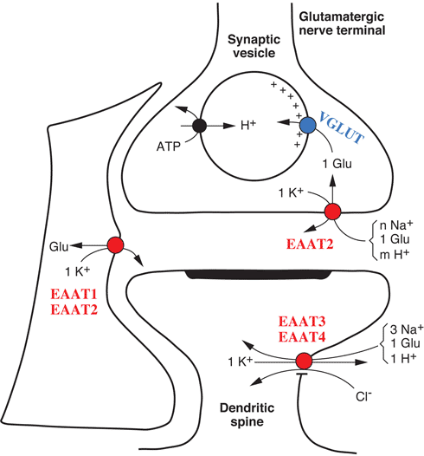
EAATs
Excitatory amino acid transporters (EAATs) transport glutamate from the extracellular to the intracellular spaces
Thereby efficiently controls the extracellular concentration of glutamate
High levels of extracellular glutamate can mediate excitotoxicity and is implicated in the pathogenesis of many brain diseases
Notes:
Multiple lines of evidence have supported a critical role for the glutamatergic system in the pathophysiology of depression

Slide 78
Hypothesis
The antidepressant effect of ketamine may be linked to the regulation of EAAT expression and the enhancement of glutamate uptake in the hippocampus of depressive-like rats.

Slide 79
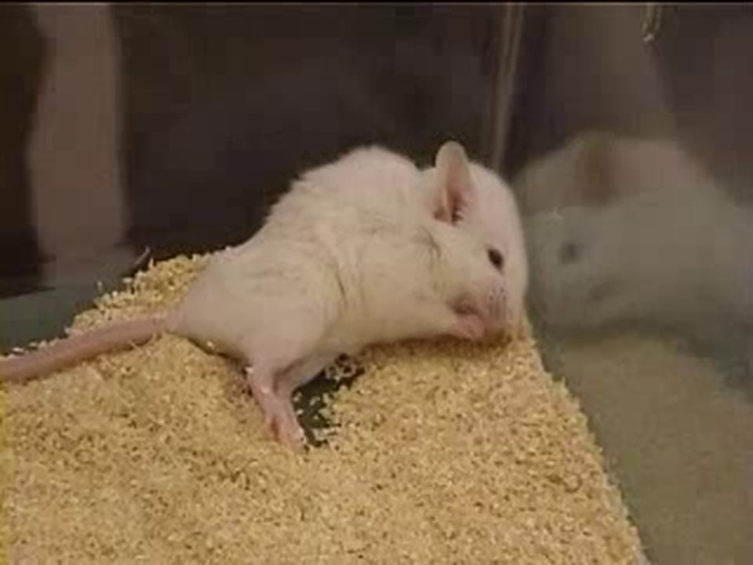
Animal models of depressive-like behavior
Chronic unpredictable mild stress (CUMS) was applied to construct animal models of depressive-like behavior
After CUMS procedure, rats were examined for depressive-like behavior by
Sucrose Preference Test
Open Field Test

Slide 80
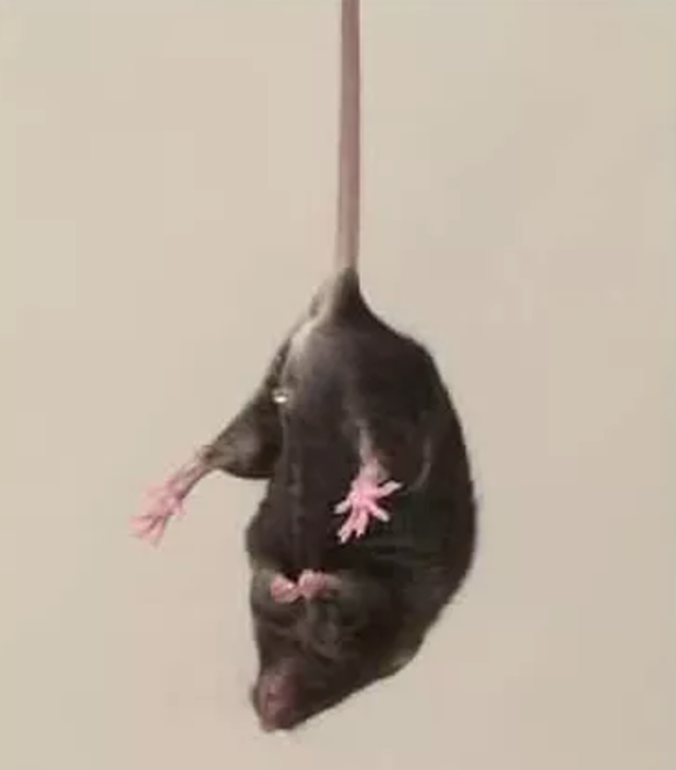
Chronic Unpredictable Mild Stress
Cold water swimming
Pinching the tail

Slide 81
Sucrose Preference Test
First 24 h, rats were exposed to two bottles of 1% sucrose solution
Next 24 h, one bottle of sucrose solution was replaced with a bottle of sterile water.
After 23 h of water and food deprivation, each rat was exposed to two identical bottles, one containing 1% sucrose and other containing sterile water.
Notes:
to habituate them to consumption of a sucrose,

Slide 82
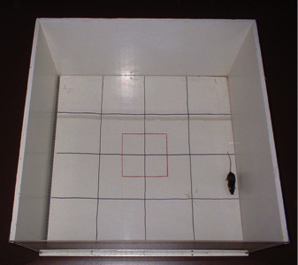
Open Field Test

Slide 83
48 rats were selected
Ketamine Treatment
SPT & OFT
Expression Analysis of EAATs in Hippocampus

Slide 84
Ketamine Treatment
Forty-eight depressive-like behavior rats were randomly assigned to four groups
Rats in group DK1 were treated with 10 mg/kg ketamine, group DK2 were treated with 25 mg/kg ketamine; group DK3 were treated with 50mg/kg ketamine
A group of 12 healthy male rats (with same age and weight) were set as the control group

Slide 85
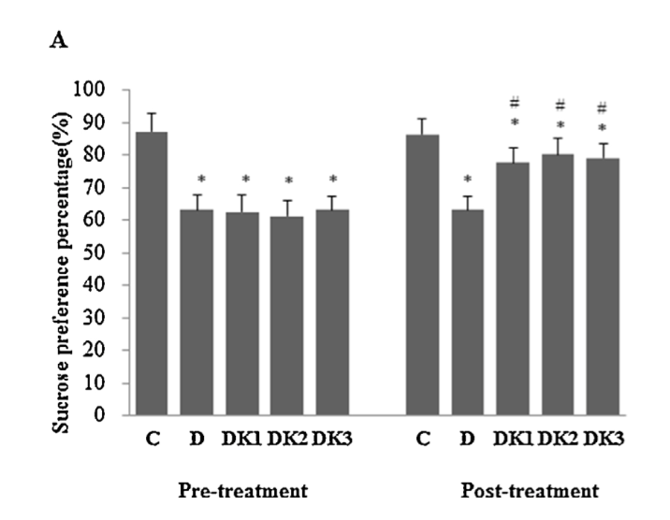
The effects of ketamine on the behavior test
Group C: control group of healthy rats
Group D: CUMS-treated
Group DK1: CUMS + 10 mg/kg ketamine
Group DK2: CUMS + 25 mg/kg ketamine
Group DK3: CUMS + 50 mg/kg ketamine
Sucrose Preference Test

Slide 86
The effects of ketamine on the behavior test
Group C: control group of healthy rats
Group D: CUMS-treated
Group DK1: CUMS + 10 mg/kg ketamine
Group DK2: CUMS + 25 mg/kg ketamine
Group DK3: CUMS + 50 mg/kg ketamine
Open Field Test

Slide 87
The effects of ketamine on the behavior test
Group C: control group of healthy rats
Group D: CUMS-treated
Group DK1: CUMS + 10 mg/kg ketamine
Group DK2: CUMS + 25 mg/kg ketamine
Group DK3: CUMS + 50 mg/kg ketamine
Times of rearing (indicating exploratory behavior)

Slide 88
Effects of ketamine on the protein expression of EAATs and extracellular concentrations of glutamate in the hippocampus of depressive-like rats Western Blotting, HPLC

Slide 89
EAAT1 Expression
Group C: control group of healthy rats
Group D: CUMS-treated
Group DK1: CUMS + 10 mg/kg ketamine
Group DK2: CUMS + 25 mg/kg ketamine
Group DK3: CUMS + 50 mg/kg ketamine

Slide 90
EAAT2 Expression
Group C: control group of healthy rats
Group D: CUMS-treated
Group DK1: CUMS + 10 mg/kg ketamine
Group DK2: CUMS + 25 mg/kg ketamine
Group DK3: CUMS + 50 mg/kg ketamine

Slide 91
EAAT3 Expression
Group C: control group of healthy rats
Group D: CUMS-treated
Group DK1: CUMS + 10 mg/kg ketamine
Group DK2: CUMS + 25 mg/kg ketamine
Group DK3: CUMS + 50 mg/kg ketamine

Slide 92
Glutamate Concentration in Hippocampus
Group C: control group of healthy rats
Group D: CUMS-treated
Group DK1: CUMS + 10 mg/kg ketamine
Group DK2: CUMS + 25 mg/kg ketamine
Group DK3: CUMS + 50 mg/kg ketamine

Slide 93
Discussion
Glutamate reuptake dysfunction is involved in the pathogenesis of depression
Expression of EAATs, especially EAAT2 and EAAT3, was obviously downregulated, extracellular glutamate levels were significantly increased in the hippocampi of depressive-like rats
Sub-anesthetic doses of ketamine (10, 25, and 50 mg/kg) upregulated the expression of EAAT2 and EAAT3 and decreased the concentration of extracellular glutamate in the hippocampus
Notes:
Thus effectively alleviated the depressive-like behavior of rats

Slide 94
Conclusions
From the first study, expression of EAAT2 and EAAT3 is involved in offspring depression induced by prenatal stress
Second study proved that, expression of VGLUT1 and VGLUT2 is involved in the acquisition and degeneration of learning and memory
And finally third study showed that, ketamine can upregulate the expression of EAAT2 and EAAT3 and decrease the extracellular glutamate concentration in hippocampus to exert antidepressant effect

Slide 95
Hypothesis is Proved
Expression of glutamate transporters might be related to depression like behavior, acquisition and impairment in memory and learning and antidepressant effect of ketamine

Slide 96
All Three studies looked for the expression of glutamate transporters in hippocampus and got convincing results
Study1:
Expression of EAAT2 and EAAT3 mRNA in hippocampus is involved in offspring depression induced by prenatal stress

Slide 97
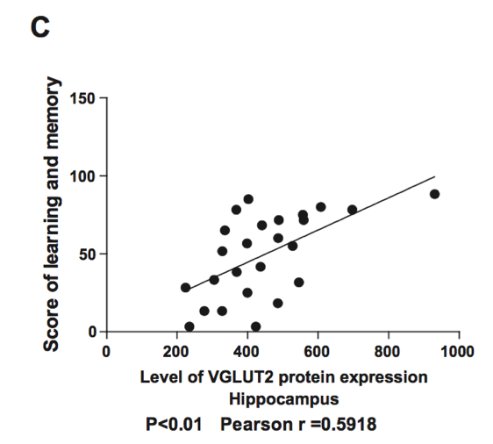
Study2: Expression of VGLUT1 and VGLUT2 in hippocampus is positively correlated with learning and memory

Slide 98
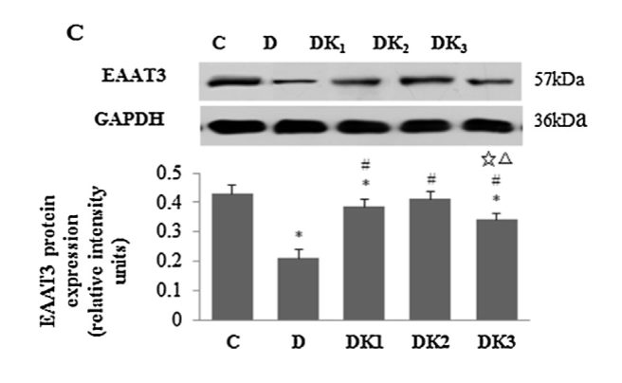
Study 3: Ketamine can upregulate the expression of EAAT2 and EAAT3 in hippocampus

Slide 99
We can say that
Expression of glutamate transporters in hippocampus is related to depression like behavior, acquisition and impairment in memory and learning and antidepressant effect of ketamine

Slide 100
HIPPOCAMPUS
= Less Glu Reuptake
= Less Activity at AMPAR
= Less Glu in Synaptic
Vesicles
= Less Glu Release
= More Glu Reuptake
= More Activity at AMPAR
= Learning Impairment?
Syp
Ketamine
NMDA
Chen, Z.-b. and T.-d. Yang (2005). "Effect of ketamine on apoptosis and synaptophysin expression in hippocampal neural cell of SD infant rats [J]." Acta Academiae Medicinae Militaris Tertiae 20: 011.
Maeng, S., et al. (2008). "Cellular Mechanisms Underlying the Antidepressant Effects of Ketamine: Role of α-Amino-3-Hydroxy-5-Methylisoxazole-4-Propionic Acid Receptors." Biological psychiatry 63(4): 349-352.
Huang, L., et al. (2012). "Ketamine potentiates hippocampal neurodegeneration and persistent learning and memory impairment through the PKCγ–ERK signaling pathway in the developing brain." Brain research 1476: 164-171.

Slide 101
Is Ketamine an Appropriate Treatment?
Notes:
Ketamine reverses symptoms of depression…however…
Ketamine may result in learning impairments

Slide 102
Take-Home Message
Prenatal Stress produces a negative effect on the glutamate-glutamine cycle by interfering with EAAT and AMPAR activity.
Learning impairments may involve an upset in the glutamate-glutamine cycle by upsetting VGLUT and Syp activity.
Ketamine may promote healthy glutamate transmission during depression through its actions on EAATs.
Notes:
Thus effectively alleviated the depressive-like behavior of rats

Slide 103
Questions?

